Slide 1

Handout and Summary of the 3rd Information and Discussion Session about the SQFCGF, held on 25. Sep. 24
Notes:
The purpose of the session is to refresh the participants‘ memory and to continue fostering awareness about the Sectoral Qualification Framework for Coast Guard Functions (SQFCGF).
Link to the SQFCGF: https://coastguard.europa.eu/sites/default/files/2023-08/01.%20Publication%20of%20SQFCGF.pdf

Slide 2

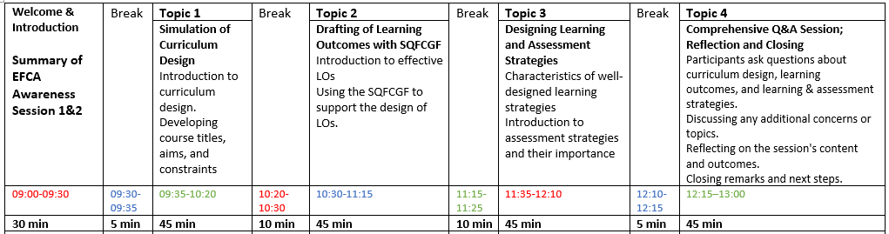
25 Sep 2024:
Notes:
The agenda of SQFCGF Awareness Session 3. Target group: persons with background as curriculum developers and/or trainers.

Slide 3



Topic 1:
Curriculum Design

Slide 4

Role in Training
Purpose
Focus
Guiding Principles
Scope
Application
Notes:
Question: How can we differentiate between Curriculum Development and the SQFCGF?
ANSWER: Curriculum Design is how educational programs are created. The SQFCGF delivers relevant Learning Outcomes according to the industrial needs.
1. Purpose
Curriculum Design: Curriculum design is the process of creating and organizing an educational program. It involves determining learning objectives, content, teaching methods, and assessments to ensure that students achieve specific learning outcomes. The purpose of curriculum design is to guide the teaching and learning process within an educational or training context.
SQFCGF: The SQFCGF is a standardized framework specific to the Coast Guard sector, outlining the qualifications, skills, and competencies needed for coast guard-related functions at different levels (4, 5, 6, and 7 of the European Qualifications Framework). Its purpose is to ensure consistency in training and qualifications across EU member states and align training outcomes with sector-specific requirements.
2. Scope
Curriculum Design: Curriculum design is broader in scope, as it applies to the process of structuring educational programs in any field or sector. It can be used for any discipline, from primary education to specialized professional training. It covers everything from learning objectives, content, teaching strategies, assessments, and course delivery.
SQFCGF: The SQFCGF is a sector-specific framework limited to the training and qualification standards for coast guard functions. Its scope focuses on the particular needs of the Coast Guard sector, helping organizations develop training programs that meet these industry standards. The framework does not dictate all aspects of curriculum design but serves as a guiding standard for the learning outcomes and competencies that must be achieved.
3. Focus
Curriculum Design: The focus of curriculum design is on the overall structure and delivery of educational content. It deals with how learners will achieve specific learning outcomes, the sequence of learning activities, the methodologies used, and how the effectiveness of the program will be assessed.
SQFCGF: The SQFCGF focuses specifically on the learning outcomes, skills, and qualifications necessary for individuals performing coast guard functions. It provides guidance on the qualifications required at different levels (from operational to managerial), offering learning outcomes and assessment benchmarks for coast guard-related tasks.
4. Guiding Principles
Curriculum Design: Curriculum design is guided by educational principles such as alignment, learner-centered approaches, scaffolding, and assessment for learning. The design process involves ensuring that teaching strategies, materials, and assessments are aligned with the learning outcomes.
SQFCGF: The SQFCGF is guided by qualifications and competencies that are specific to the Coast Guard sector. It ensures that the qualifications meet international standards and are recognized across the EU. The focus is on defining the necessary competencies for each function level and ensuring that training programs produce skilled personnel who can operate in accordance with these standards.
5. Role in Training
Curriculum Design: In the context of the Coast Guard, curriculum design would involve taking the SQFCGF and using it as a basis to create a structured learning experience. It would specify the content to be taught, the sequence of lessons, the teaching methods, and the assessment strategies to ensure learners meet the outcomes defined by the SQFCGF.
SQFCGF: The SQFCGF acts as the standard or benchmark against which coast guard training programs are designed. It defines what learners need to know and be able to do at different qualification levels but does not dictate the specific teaching methods, lesson plans, or assessment tools to be used. Curriculum design takes the framework’s qualifications and builds an instructional program around them.
6. Application
Curriculum Design: Curriculum design applies broadly to all educational and training programs. In the case of coast guard training, curriculum designers use the SQFCGF as a foundation but still need to make decisions about course structure, content, materials, and teaching strategies to meet the specific needs of the learners.
SQFCGF: The SQFCGF applies specifically to the coast guard sector, ensuring that coast guard functions across EU member states are standardized and that qualifications meet agreed-upon levels. It is not a process, but rather a framework to be followed during the curriculum design process for coast guard-related courses.

Slide 5
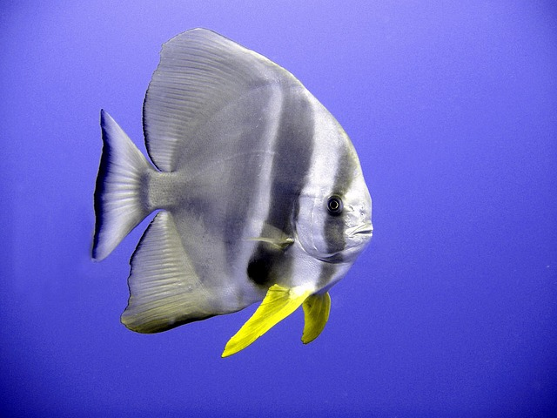
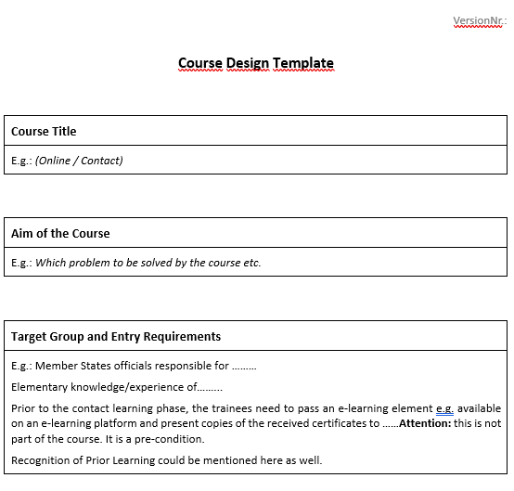

Notes:
We looked into the process of course design. There it became quickly clear: if we make good use of a template approach, course design can be mastered well.
A course design template with supportive explanations was delivered to the participants. May it be of a great value!
In the session we referred to chapters of the template:
A course aim is a broad, overarching statement that describes the purpose and goals of the course as well as which problems the course tries to solve. It provides a high-level view (holistic) of what the course intends to achieve and guides both instructors and learners in understanding the general direction of the course. The aim is typically more general than learning outcomes, which are more specific and measurable.
A well-crafted course aim sets the tone for the course and helps both learners and instructors stay focused on the primary goals throughout the course.
Target Group Statement
A brief description of the audience for whom the course is designed. It should specify who the course is intended for, considering professional roles, industry, or experience level.
"This course is designed for mid-level Coast Guard officers, curriculum developers, and training coordinators involved in developing and implementing training programs aligned with the SQFCGF.“
Entry Requirements Statement
A statement outlining the necessary qualifications, skills, or knowledge learners should have before enrolling in the course. It helps ensure participants are adequately prepared.
"Participants should have at least three years of experience in coast guard operations or related fields and a basic understanding of training and qualification frameworks."

Slide 6

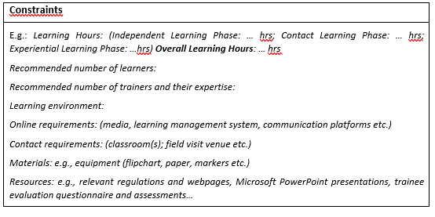



Notes:
Course Constraints: Identifying and acknowledging Course Constraints early on helps in planning how to overcome or mitigate their impact while still achieving the course objectives.
Course Constraints refer to the limitations or challenges that might affect the design, delivery, or participation in a course. These constraints need to be considered during the curriculum development process to ensure realistic and effective planning.
Common course constraints can include time, resources, participant background, and logistical factors.
The total available time for delivering the course.
Equipment availability of teaching materials, technology, or access to facilities or experts.
Personnel required and their competence etc.

Slide 7
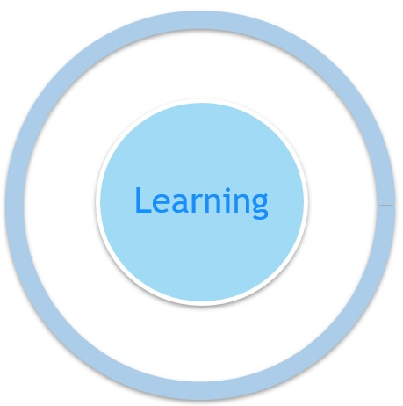
Learning Outcomes & Constructive Alignment
Learning Outcomes
Learning Outcomes
Learning Activities
Assessment
Notes:
Topic 2 - Learning Outcomes, the core elements of the SQFCGF.
A Learning Outcome is a clear, concise statement that describes what learners are expected to know, understand, or be able to do by the end of a course, lesson, or training program.
LOs focus on the results of learning rather than on the learning process itself, and they are typically measurable, specific, and action-oriented.
They are explicit descriptions of what a learner should know, understand and be able to do as a result of learning. At the same time they indicate a ‘threshold’ of learning, a minimum standard of learning.
The concept of Constructive Alignment was developed by John Biggs (an Australian educational psychologist). This concept is very helpful in order to visualize the interconnections between learning outcomes, learning activities and assessments. This all goes together with how adults learn and construct their knowledge and skills bit by bit – illustrate this with for example how to build a brick house – a bit by bit the house takes form, and it is also important to take measurements and know the different parts (eg. how to build a wall, what are the important elements of a floor etc) in order for it to be a sturdy house. It’s the contrast between short vs. long-term memory.
In training design, this model is very helpful to structure the training in order for it to support the learning taking place for the learners. In this sense we must ask ourselves: How do adults learn the best?
When planning and choosing learner-centred learning activities, the trainer needs to have a good understanding of the learning outcomes. What are the learners supposed to know, understand or be able to do after the training? What are the learning outcomes for your session? The learning activities must then support the learning that leads towards the learning outcomes, with a high degree of activation of the learners in their own process of learning.
This in turn leads to assessment, or assessment methods, that measure the learners’ ability to fulfill the learning outcomes.
Thus, the whole course, or session, will be constructively aligned to create the conditions for learning.

Slide 8
Components of a Learning Outcome
By the end of this topic,
participants will be able to…
…correctly deconstruct one learning outcome taken from the SQFCGF.
1) One ACTIVE VERB form;
2) Indication of the TYPE OF LEARNING OUTCOME:
Knowledge / Skill / Responsibility and Autonomy (Competence);
3) TOPIC AREA of the learning outcome: specific or general (refers to the subject matter or field);
4) Indication of the STANDARD or the COMPLEXITY OF LEARNING that is intended/achieved by the learning outcome;
5) SCOPE and/or CONTEXT of the learning outcome.
Notes:
This slide shows the Components of a well drafted Learning Outcome.

Slide 9

Deconstructing a Learning Outcome & Visual display
LO
 | TOPIC | STANDARD & SCOPE | ACTION VERB | TYPE OF LO
COORDINATE an effective response to maritime border surveillance incidents and SAR emergencies in cooperation with other relevant partners and agencies.
Cooperation with other relevant partners and agencies
- Maritime border surveillance incidents
- SAR emergencies
Responsibility & Autonomy
COORDINATE
Notes:
We then thought about how to deconstruct Learning Outcomes. But Why???
Answer: As trainers, before we even start the process of planning our sessions, we must face the challenge of fully understanding what the intended learning outcomes for that session really mean.
Deconstructing the learning outcomes should be the very first step in planning effective instruction and assessment.
One thing is to read a learning outcome and get a general sense of what it's about.
It's another thing to thoroughly understand what it explicitly and implicitly indicates.
What is it that learners must know, understand and/or be able to do as stated in each of these learning outcomes?
Why deconstruct a learning outcome?
Because as trainers, if we are not completely aware of the full and precise intent of a given learning outcome…
A) How can we successfully drive learners in their achievement of the specific learning of a session?
B) How can we accurately plan it in terms of activities, methods, resources, contingency plans, etc. ?
C) How can we objectively assess participants’ achievement of it?

Slide 10

Notes:
The SQFCGF provides a structured system of industry-related Learning Outcomes. The Designing of Curricula is an additional skill.

Slide 11





Firing Skills Test???
LS
AS
Notes:
We took a closer look at other chapters of the curriculum design template: LS: Learning Strategy and AS: Assessment Strategy
LS: For instance, a boy wants to learn how to swim. If the learning method is wrong (e.g. reading books about swimming; watching swimmers) the boy will never learn it.
AS: If we wish to assess practical skills, a multiple choice test is not the right assessment method.
A learning strategy is a planned approach or method used to help learners effectively acquire knowledge and skills. It involves techniques, activities, or processes designed to facilitate learning and improve retention, understanding, and application of content.
Purposeful: Designed to achieve specific learning outcomes.
Learner-Centered: Focuses on how learners engage with and process information.
Varied: Can include methods like problem-solving, group work, discussions, case studies, or hands-on practice.
Adaptable: Tailored to different learning styles, levels, and contexts.
E.g. The course is work-based and follows a structure of: Course; Module(s); Phases; Sessions; e.g.: Course has 1 Independent Learning Phase, 1 Contact Learning Phase; 1 Experiential Learning Phase.
…The course uses a blended learning approach, which combines self-paced individual online learning (during an Independent Learning Phase - ILP) with face-to-face learning in online contact setting (during a Contact Learning Phase - CLP).
During the ILP (amount of learning hours) learners will achieve the knowledge base and introduce skills that will be developed and practiced in the CLP. The ILP is delivered online using interactive online learning activities, online practice tasks / quizzes to facilitate learning through practice and to enable learners to evaluate the progress of their learning. Online reference materials, available on the e-learning platform, are used to introduce, summarise, and signpost key findings.
The CLP (amount of learning hours) aims to develop, practice, and assess skills needed by the target group, in particular (description of required skills). A learning-by-doing approach is used with a structured set of practical sessions The CLP includes practical activities and tasks which provide opportunities for learners to develop and practice skills, judge their own progress, give, and receive feedback from peers and tutors.
An assessment strategy is a planned approach to evaluating and measuring learners' progress, understanding, and achievement of learning outcomes. It outlines the methods, tools, and processes used to assess learners’ knowledge, skills, and competencies throughout a course or program.
Key Points:
Purposeful: Designed to align with and measure the achievement of specific learning outcomes.
Varied Methods: May include quizzes, exams, practical tasks, projects, presentations, or reflective activities.
Formative and Summative: Can involve ongoing assessments (formative) to provide feedback during the learning process, or final assessments (summative) to evaluate overall achievement.
Fair and Inclusive: Should accommodate diverse learning styles and be accessible to all learners.
E.g. There are two assessments: a theoretical one, conducted online at the end of ILP, and a combination of a theoretical multiple-choice test and two practical case studies conducted online at the end of the CLP. Both assessments must be passed for a successful completion of the course. The quiz in the end of ILP will support learners to reach their LOs. However, if the assessment in the end of the CLP is failed, there will be one opportunity for re-assessment.
All assessments including re-assessments will be conducted in line with relevant policies and procedures.

Slide 12

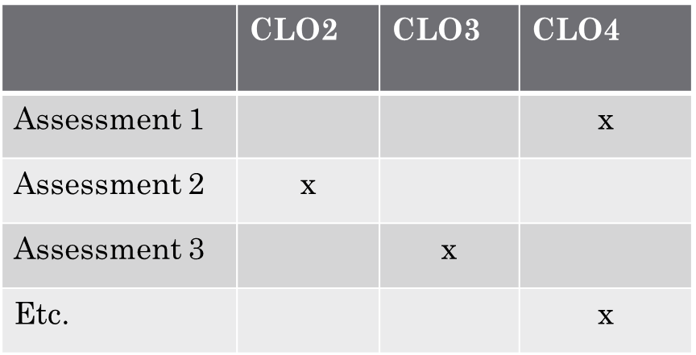
Assessment Methods
Weight of Assessments
Description of Assessments
Assessment Descriptors
Notes:
Elements of Assessment Strategies and by using the Cross Referencing Method, we can check,if every Learning Outcome is getting assessed.

Slide 13
Single Module Course: LOs Breakdown Structure
SQFCGF
Single Module Course
CLO1; CLO2; CLO3; CLO4…
Single-level course
LO 1; LO 2; LO 3; LO 4…
Session 1
S1LO1; S1LO2; S1LO3…
Session 2
S2LO1; S2LO2; S2LO3…
Session 3
S3LO1; S3LO2; S3LO3…
Session 1
Session 2
Session 3
LO 1; LO 2; LO 3…
LO 1; LO 2; LO 3…
LO 1; LO 2; LO 3…
Notes:
Analysis of a breakdown structure of a single module course, to assist us to understand the connection between Course Learning Outcomes (they are generally formulated) and Session Learning Outcomes (they are formulated more precisely). Both groups should be aligned to the SQFCGF without being copy-paste versions of the SQF.

Slide 14




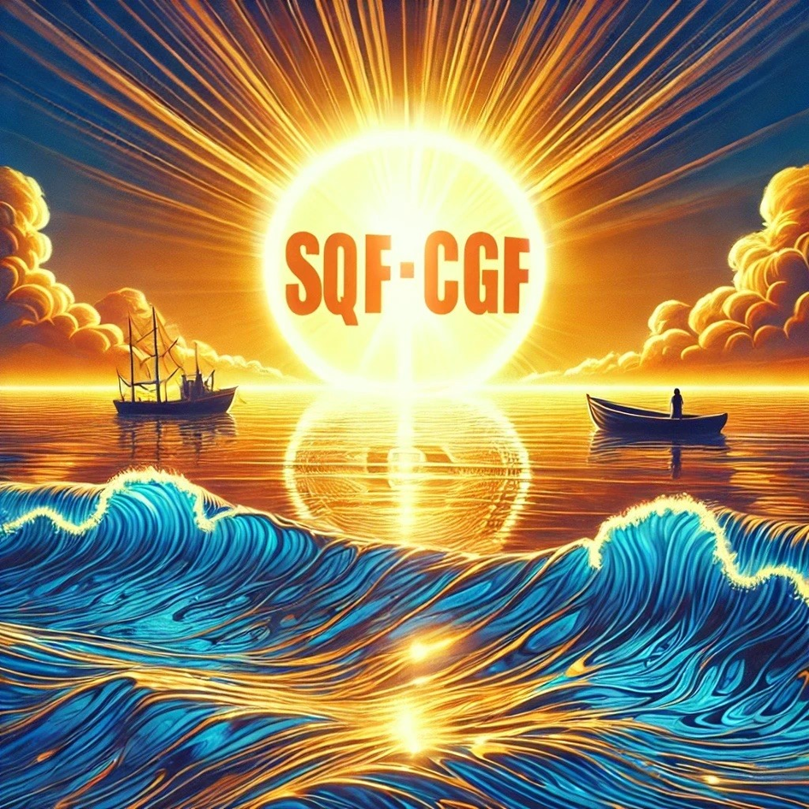

Notes:
Implementing SQFCGF also requires management support to ensure the adequate staff, competences and structures are in place.

