Slide 1



Handout and Summary of the 4th Information and Discussion Session about the SQFCGF, held on 06. November 24
Notes:
The 4th Information and Discussion Session
Aims to refresh participants’ memories and further promote awareness of the SQFCGF.
All images included are sourced from Pixabay or generated through AI.
Link to the SQFCGF: https://coastguard.europa.eu/sites/default/files/2023-08/01.%20Publication%20of%20SQFCGF.pdf

Slide 2
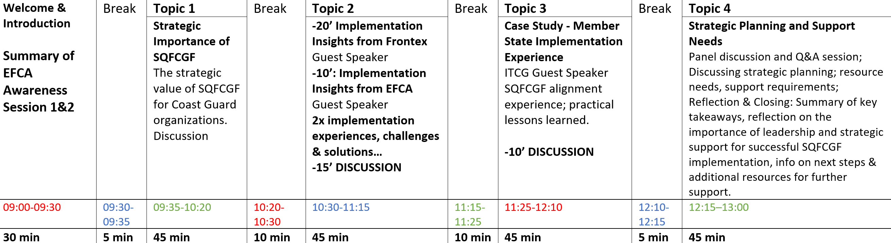
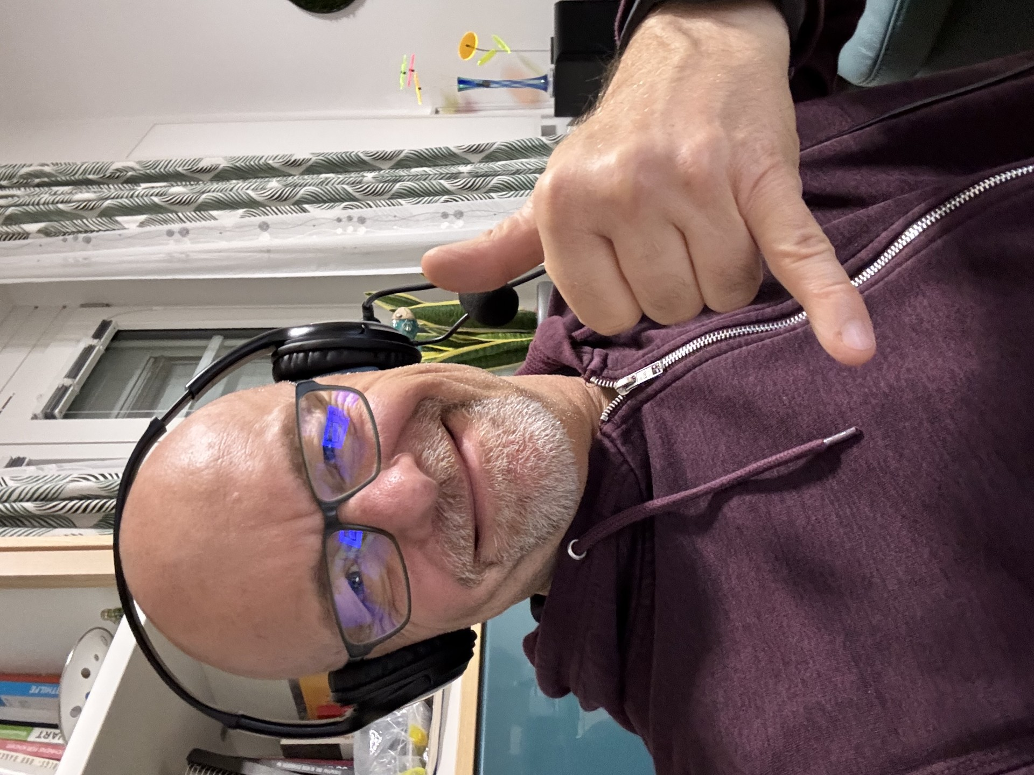
06 Nov. 2024:
Notes:
The agenda of SQFCGF Awareness Session 4.

Slide 3
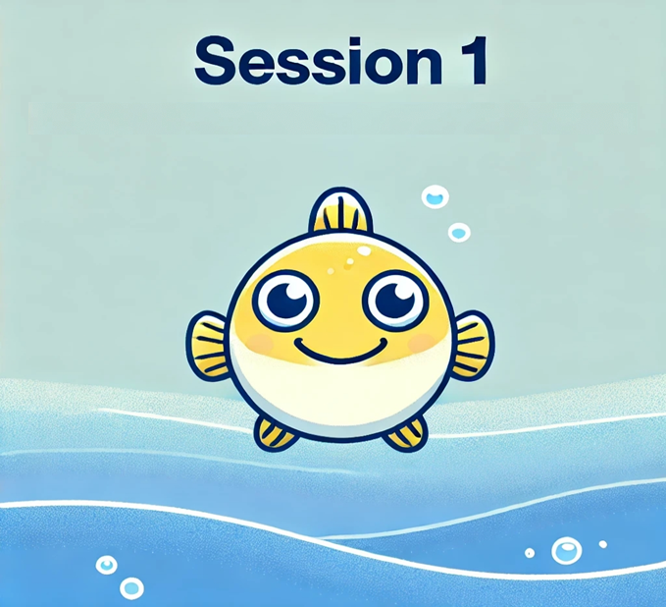
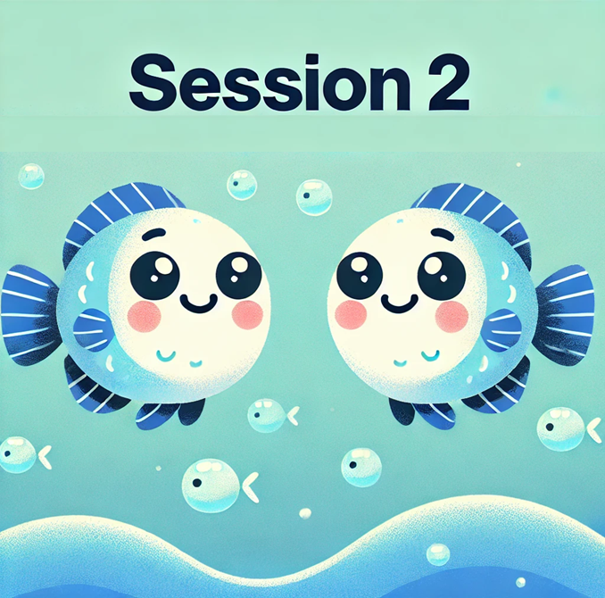
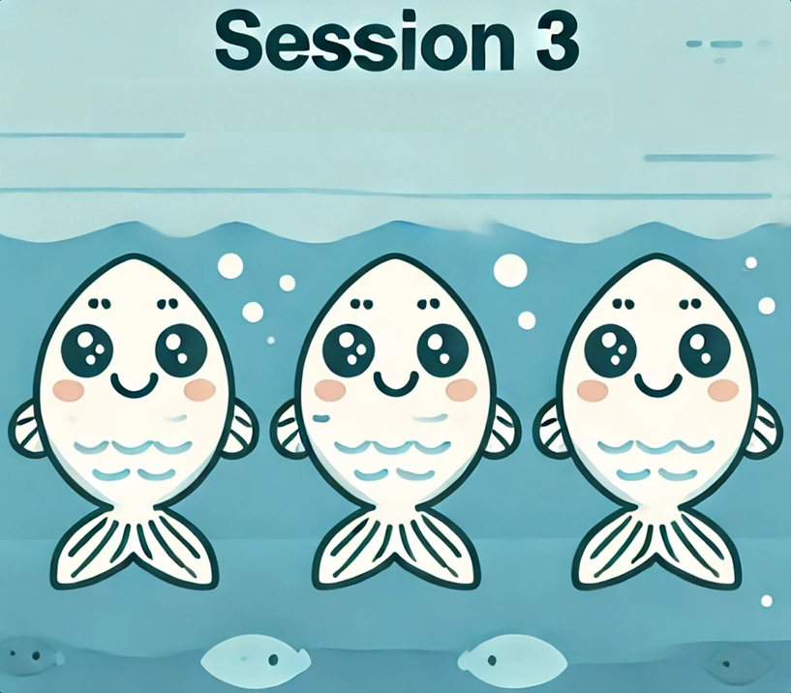

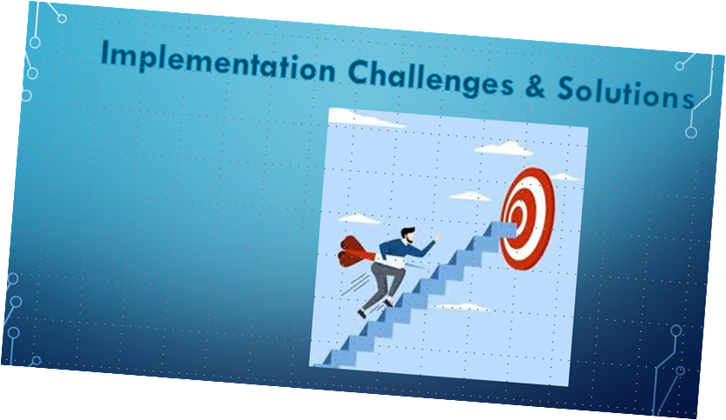
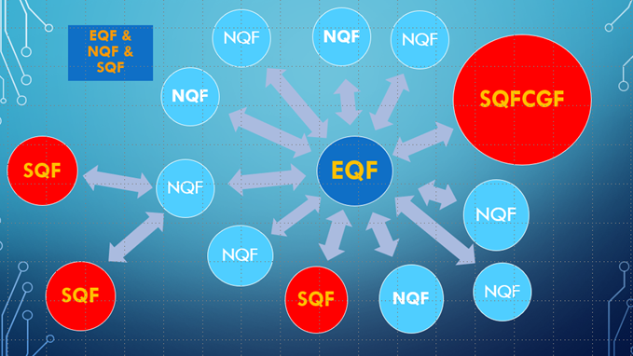

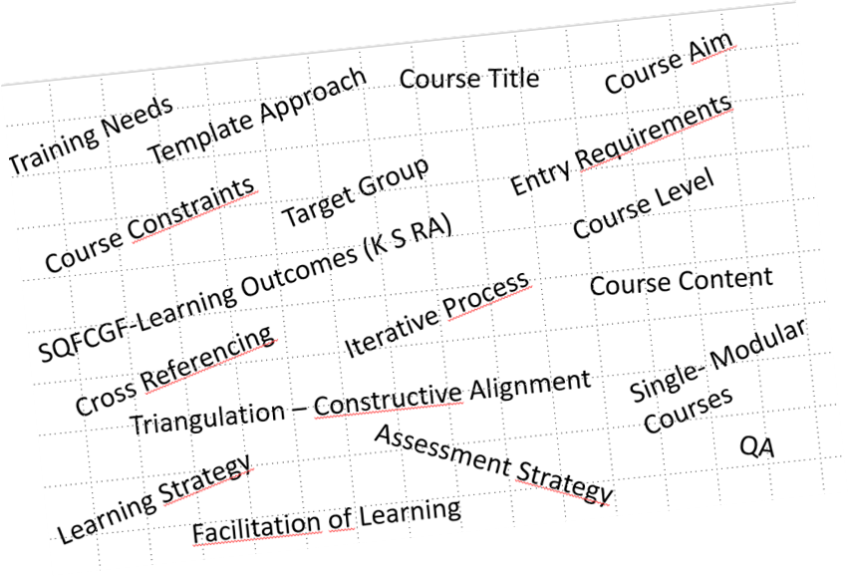
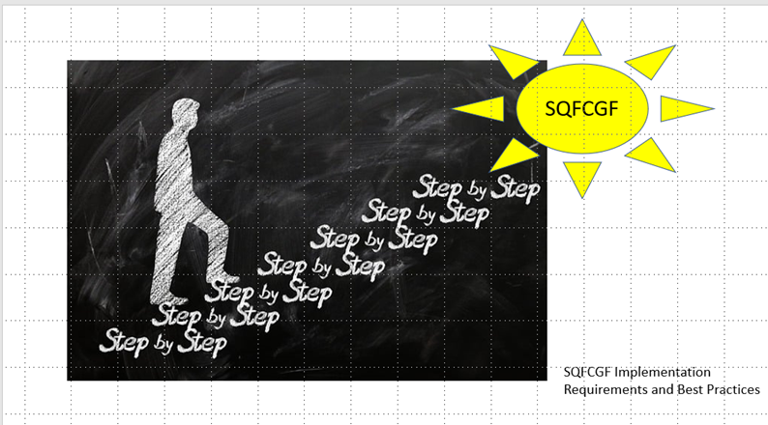
Learning & Assessment Strategies
Course Design Template
QA
Constructive Alignment
Notes:
Brief overview of the key points from SQFCGF Information Sessions 1, 2, and 3.
Session 1: April 9, 2024
Introduced the Sectoral Qualification Framework for Coast Guard Functions (SQFCGF)
Highlighted the significance of standardizing qualification frameworks across coast guard functions
Focused on the structure of the SQFCGF and its alignment with EU standards to ensure quality assurance
For QA guidelines, refer to ESG2015
Session 2: May 22, 2024
Delved into the design of learning outcomes
Demonstrated how SQFCGF contributes to enhancing workforce competence
Engaged in case studies and practical exercises on drafting learning outcomes using SQFCGF principles
Session 3: September 25, 2024
Presented the curriculum design template, with a focus on curriculum development, including the formulation of learning outcomes and strategies for learning and assessment
Note: SQFCGF serves as a foundational framework but is not a direct curriculum design tool
Examined the alignment of SQFCGF with organizational needs
Conducted exercises connecting learning outcomes to course design and provided an introduction to constructive alignment

Slide 4

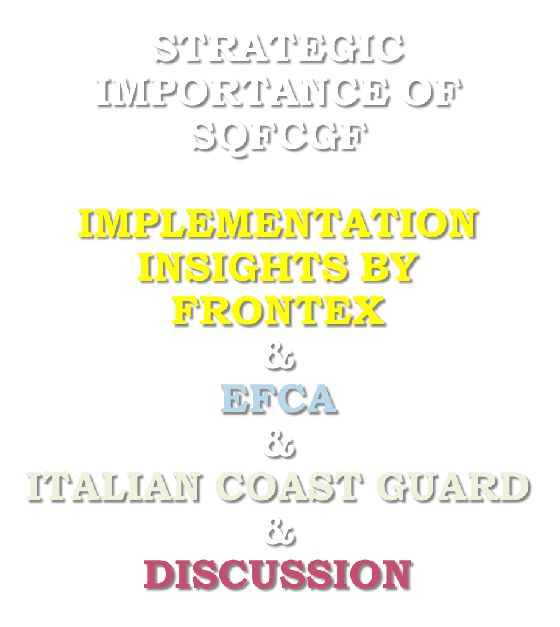
SQFCGF as our guiding star
Notes:
After each session, the invaluable feedback from participants has guided the development of subsequent content, particularly for this final SQFCGF Awareness Session 4.
This slide outlines the topics to be covered.

Slide 5
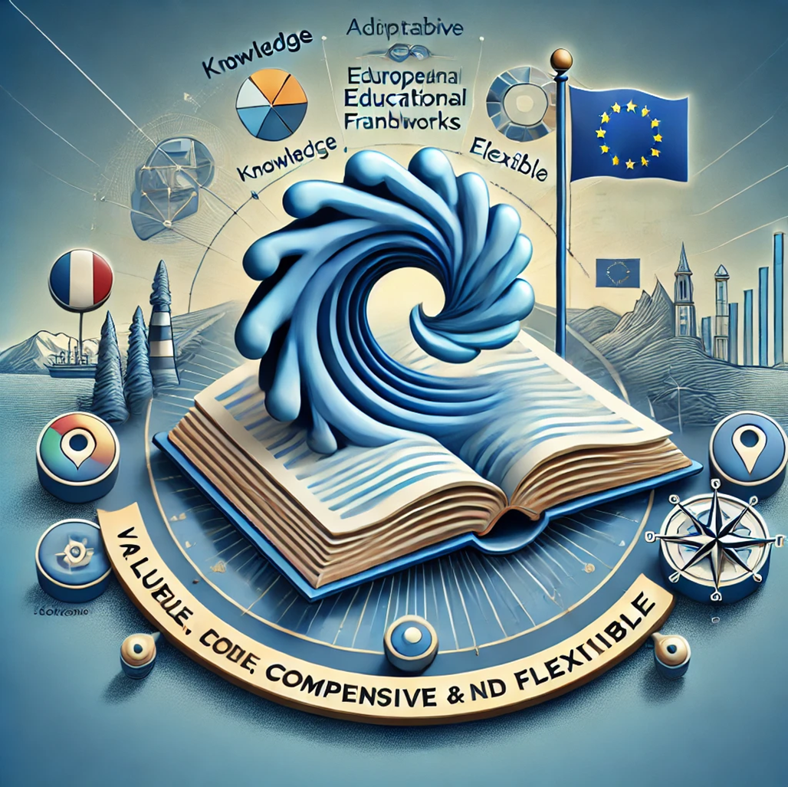

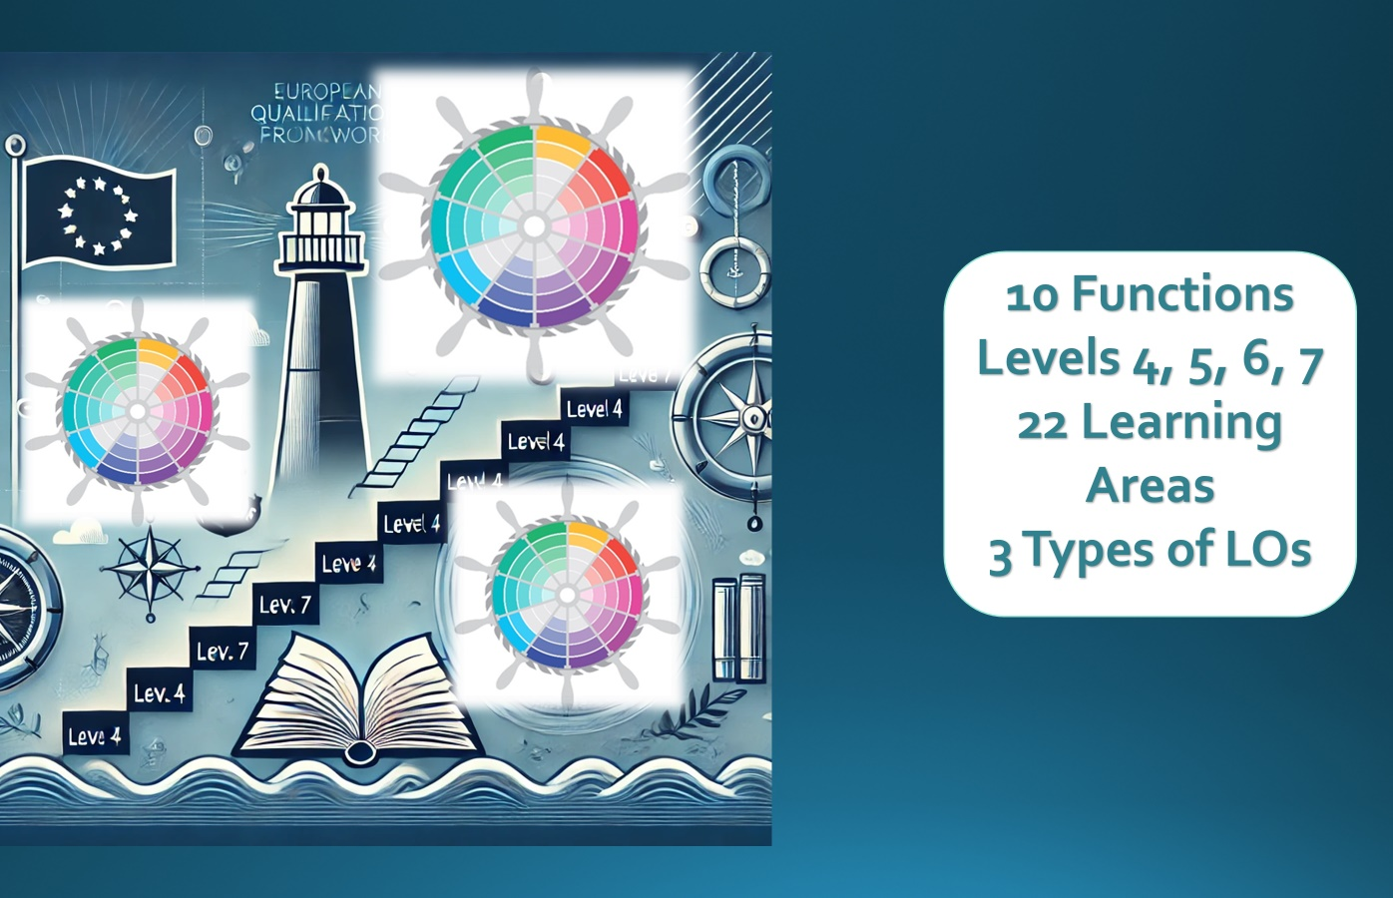







Learning Outcomes and Progression
Outlines learning outcomes for 10 coast guard functions
Demonstrates POL from level 4 to level 7
Aligns with European Qualifications Framework (EQF)
Learners‘ Perspective
Teacher Centered Education
Notes:
Topic 1 highlighted the strategic importance of the SQFCGF for organizations with coast guard and fisheries responsibilities:
Emphasized the alignment of these functions with EU maritime safety objectives
Stressed the need for cross-border compatibility and interoperability among national agencies
Cross-border compatibility: Supports the harmonization of training across EU member states
Interoperability: Enhances cooperation between national coast guard agencies
The SQFCGF serves as a valuable, comprehensive, and adaptable framework for coast guard education, aligning seamlessly with European educational standards (Bologna and Copenhagen) and emphasizing learning outcomes from a learner-centered perspective. This approach signifies a departure from traditional, teacher-centered methods.
The SQFCGF is instrumental in standardizing and advancing coast guard education, focusing on learning outcomes and the learner's perspective.
Progression of Learning (POL): The framework specifies learning outcomes across 10 key coast guard functions, illustrating a clear learning progression from levels 4 to 7, fully aligned with the European Qualifications Framework (EQF).
Collective Agreement: Participants have agreed to avoid the term "Implementing the SQFCGF." Instead, we adopt the phrase "Aligning our own learning outcomes with the learning outcomes offered by the SQFCGF."

Slide 6
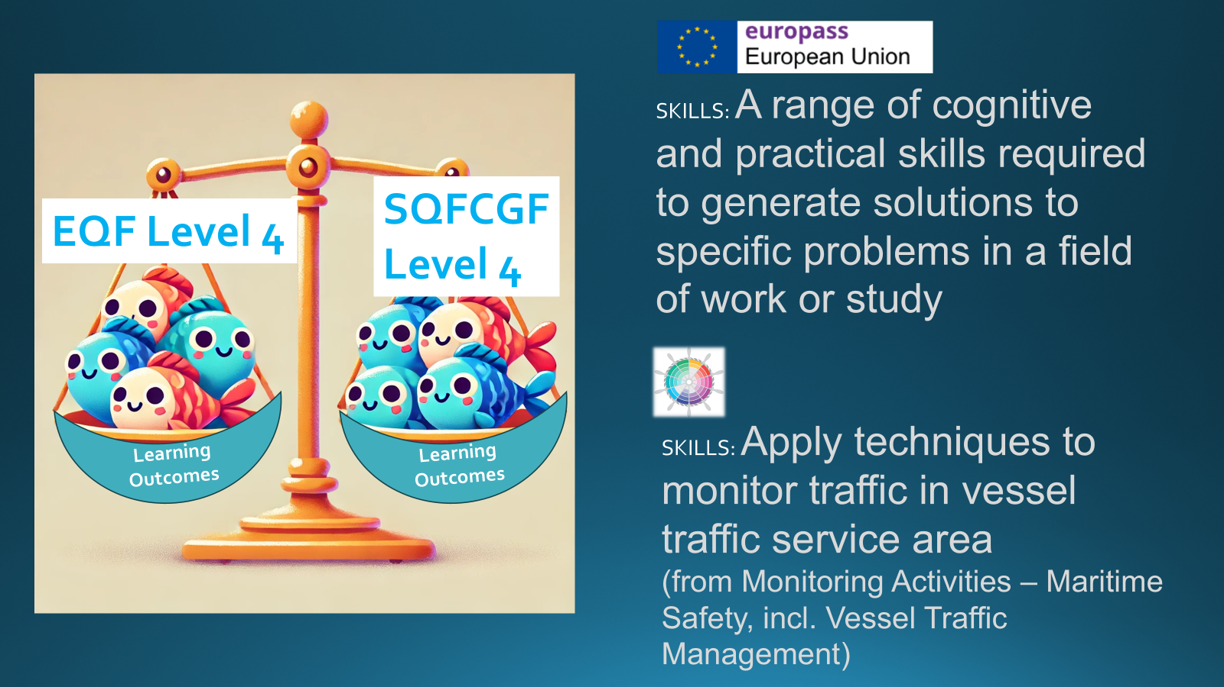

LOs are:
Explicit description of what a learner should know, understand and be able to do as a result of learning.
They indicate a ‘threshold’ of learning, a minimum standard of learning.
LOs do not include the word ‘teach’!
Notes:
EQF: Description of the eight EQF levels | Europass
We conducted a comparison between an EQF Level 4 Learning Outcome and an SQFCGF Level 4 Learning Outcome. This comparison provides valuable insights into the distinct value of the SQFCGF.
Key Components of a Well-Formulated Learning Outcome:
Active Verb
Type of Learning Outcome (LO)
Topic Area
Scope/Context
In deconstructing the EQF Learning Outcome (which requires a range of cognitive and practical skills to generate solutions to specific problems in a field of work or study), we observed that these core components are not consistently present.
Differences Observed in EQF Learning Outcomes:
Lacks specificity and context, using general language without sectoral focus
Omits relevant standards or benchmarks, with no defined scope (e.g., beginner vs. advanced proficiency)
Mismatch with real-world skills; translating EQF’s abstract outcomes into industry-relevant skills can be time-intensive
General focus on "comprehensive" or "advanced" skills provides limited guidance for developing accurate assessments
Generalized language makes consistency in training and assessment challenging, especially in standardized fields like coast guard functions
Curriculum developers require sophisticated expertise in educational principles and industry-specific skills, adding complexity and time to customization efforts
Advantages of SQFCGF Learning Outcomes:
Industry-Specific: Clear expectations for skills directly related to maritime surveillance
Action-Oriented: Specific verbs like "operate," "monitor," and "interpret" align with Bloom's Taxonomy, giving curriculum developers concrete tasks
Defined Scope and Context: Relevant to maritime zones, vessel monitoring, and risk assessment, directly applicable to coast guard operations
Clear Standards: Adheres to established protocols and national security guidelines, ensuring appropriate skill complexity and rigor

Slide 7
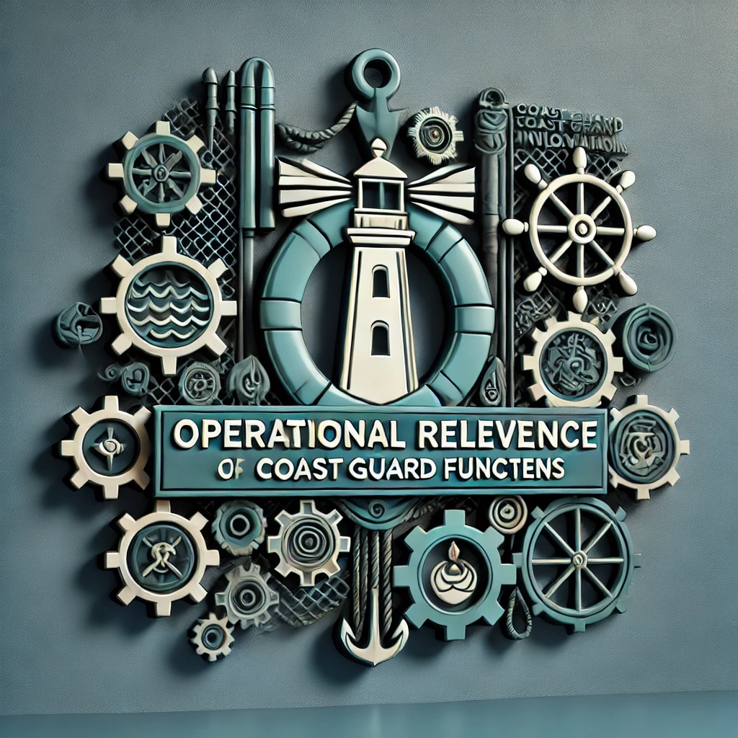
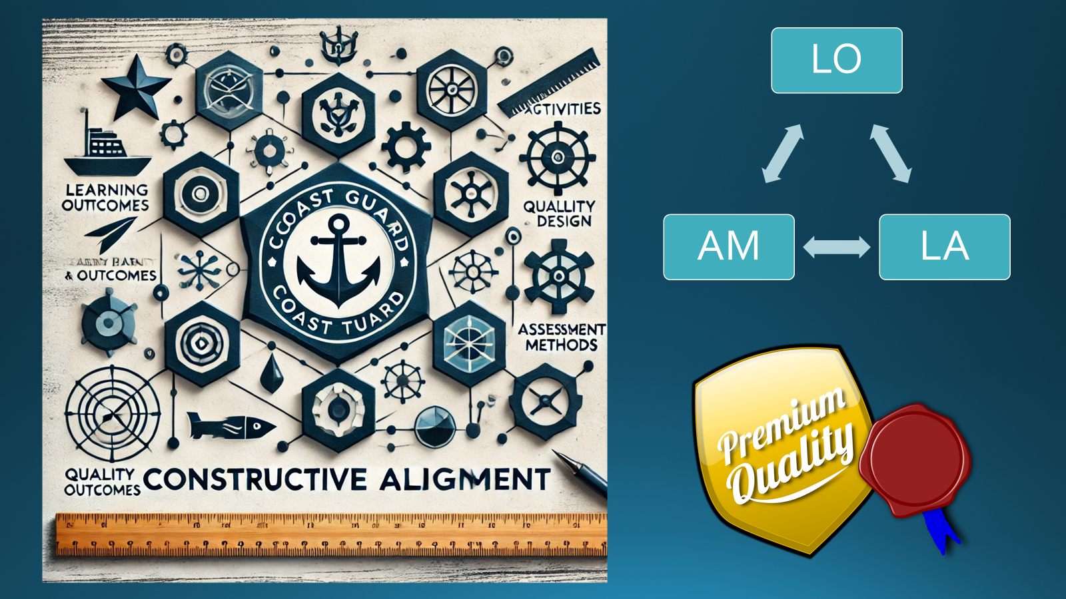
Notes:
One of the SQFCGF’s greatest strengths lies in its operational relevance. Designed with input from experienced stakeholders, it addresses real-world needs, making it highly valuable for both employers and employees. The framework facilitates the integration of coast guard education within the National Qualifications Framework (NQF), thereby supporting quality assurance and certification in education. As a reliable reference, it assists course designers, academic standards, and operational roles, enhancing the design and evaluation of programs, courses, and training sessions.
The SQFCGF combines the broad benefits of the EQF with added specificity by providing:
Clear terminology and practical actions tailored to coast guard operations
Contextual requirements, enabling curriculum developers to:
Create relevant, realistic learning outcomes
Align training with job expectations
Simplify assessment design through detailed standards
Constructive Alignment of Learning ensures that learning outcomes, activities, and assessment methods work in harmony, creating a seamless educational experience. This alignment shifts the focus from a teacher-centered to a learner-centered approach, reinforcing quality assurance and certification. As a result, training certificates gain higher value, positively influencing career paths. The outcome is enhanced credibility and recognition of training programs.

Slide 8

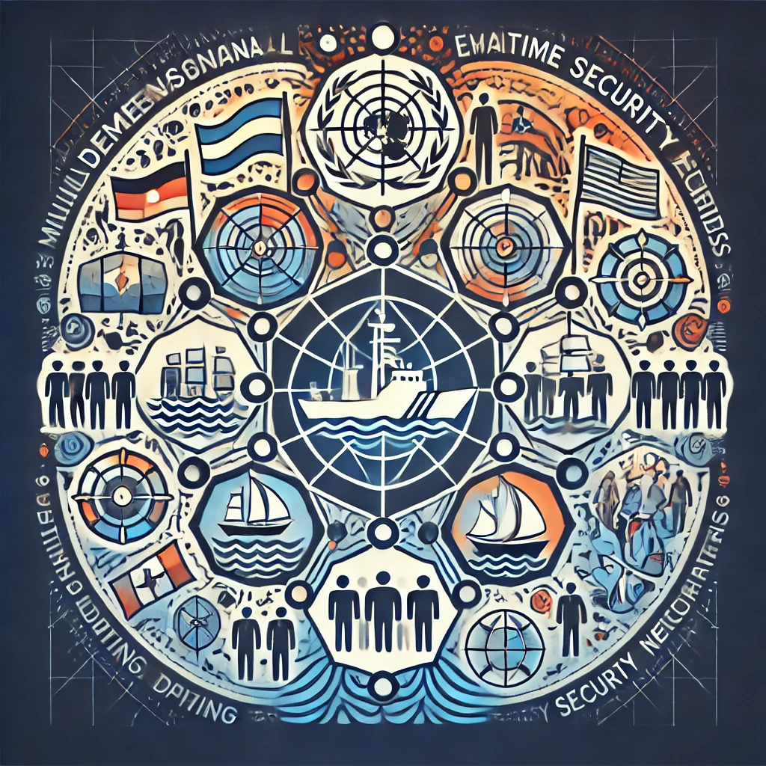

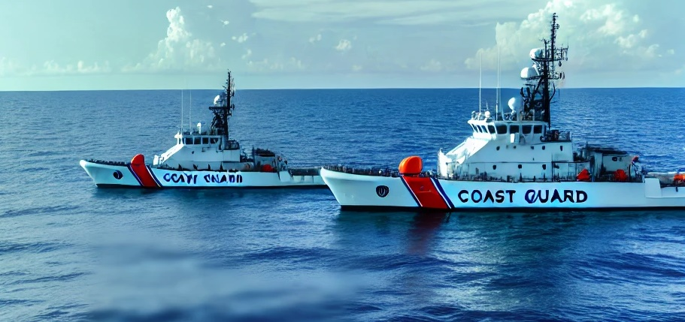



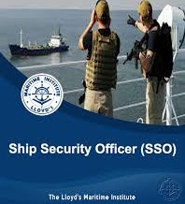
Notes:
The SQFCGF is supporting multi-dimensional Coast Guarding
Helps in multi-language, multicultural, and multi-agency environments
Provides clarity and acts as a translation tool for communication
Adapts to evolving maritime security needs
Additionally, the SQFCGF is designed to support the complex, multidimensional nature of coast guard operations, which frequently require coordination across multiple languages, cultures, states, and agencies. By providing standardized terminology, it serves as an effective “translation tool” for individuals from diverse cultural and linguistic backgrounds, bridging communication gaps. This makes the framework especially well-suited to the dynamic and challenging field of coast guarding, ensuring that education and training are continuously aligned with real-world operational demands.

Slide 9

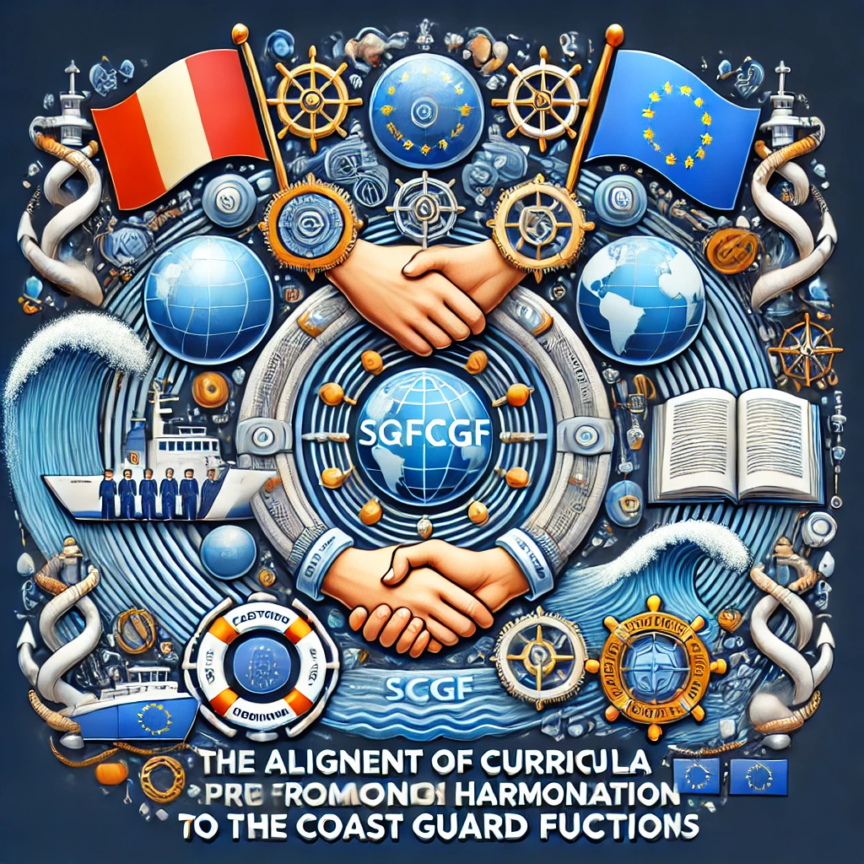




Notes:
Aligning curricula to the SQFCGF promotes harmonization of coast guard education and practises in coast guarding.
How do we approach the SQFCGF learning outcome, if we think, it could be suitable for our course or session descriptor?
Because of its purpose, an SQFCGF learning outcome is not specific enough for a particular coast guard function or organizational need. We apply certain strategies to adapt SQFCGF learning outcomes to meet the specific requirements of coast guard organizations. In other words: the SQFCGF is adaptable, flexible, and practical. It is meant to ensure that training aligns closely with real-world responsibilities and operational needs.
What to do? Apply the following strategies!!!
1. Customize the Learning Outcome (LO)
Deconstruct the LO: Analyze each component of the SQFCGF LO—such as the active verb, skill type, context, and complexity level—and identify where further specificity is needed.
Adapt the LO to reflect specific operational contexts, equipment, or procedures used by the organization.
Set concrete performance standards that indicate how well a learner should perform a task. This could involve establishing speed, accuracy, or adherence to particular guidelines as part of the LO.
2. Integrate Job-Specific Terminology and Scenarios
Use real-world scenarios which learners are likely to encounter in their specific roles.
Embed industry-specific terminology that reflects the language of the job and organization.
3. Refine Through a Task Analysis
Break down the job tasks (required job competences) associated with the LO into their component parts to reveal skills, knowledge, and responsibility and autonomy required.
If the LO involves a complex task (e.g., risk assessment in maritime zones), the analysis can help add detail about the procedures, tools, or decision-making skills involved.
4. Align with Organizational Standards and Protocols
Integrate the organization’s unique protocols, guidelines, or technology into the LO and tailor them according to the needs of the operational environment.
Set clear operational benchmarks that align with the organization’s performance expectations (specific response times, decision criteria, or quality standards).
5. Develop Complementary Micro-Outcomes
Add sub-LOs for specific skills: If the SQFCGF LO is too broad, create micro-learning outcomes that focus on specific skills or knowledge areas under the umbrella of the original LO. These smaller outcomes can guide the creation of targeted training activities. This creates a hierarchy of LOs: Course LOs and Session Los…with a clear structure.
Design LOs that ensure a progression of learning. In other words, they increase in complexity, allowing learners to build proficiency in a structured way.
6. Pilot and Refine the Learning Outcome
Implement the LO in training exercises or simulations and gather feedback (Quality Assurance!!!) from both instructors and learners. This reveals gaps in specificity and allows to refine materials based on feedback. This is the way how to adjust the LO’s clarity, relevance, and specificity, ensuring it meets practical needs.

Slide 10

Conclusions of the Session on Strategy:
The SQFCGF…
…is essential for aligning CGF with EU goals
…supports cross-border compatibility, QA processes, and organizational agility
…facilitates adaptation to evolving maritime security, environmental, and law enforcement needs
Notes:
CGF: Coast Guard Functions

Slide 11

The SQFCGF is a valuable tool that needs to be used.
The national Learning Outcomes shall be tailored from the SQFCGF Learning Outcomes. The rest is curriculum design.
Notes:
A special thanks to the Italian Coast Guard and Ms. Elisa Giangrasso, whose extensive experience as a co-designer of the SQFCGF has highlighted the framework’s value. Elisa demonstrated that the SQFCGF is indeed a powerful tool, capable of supporting the design of operationally relevant curricula. She shared how the Italian Coast Guard successfully navigated numerous challenges throughout the process. Congratulations, and sincere thanks for offering support to other organizations in need of assistance. This is a shining example of effective networking!

Slide 12
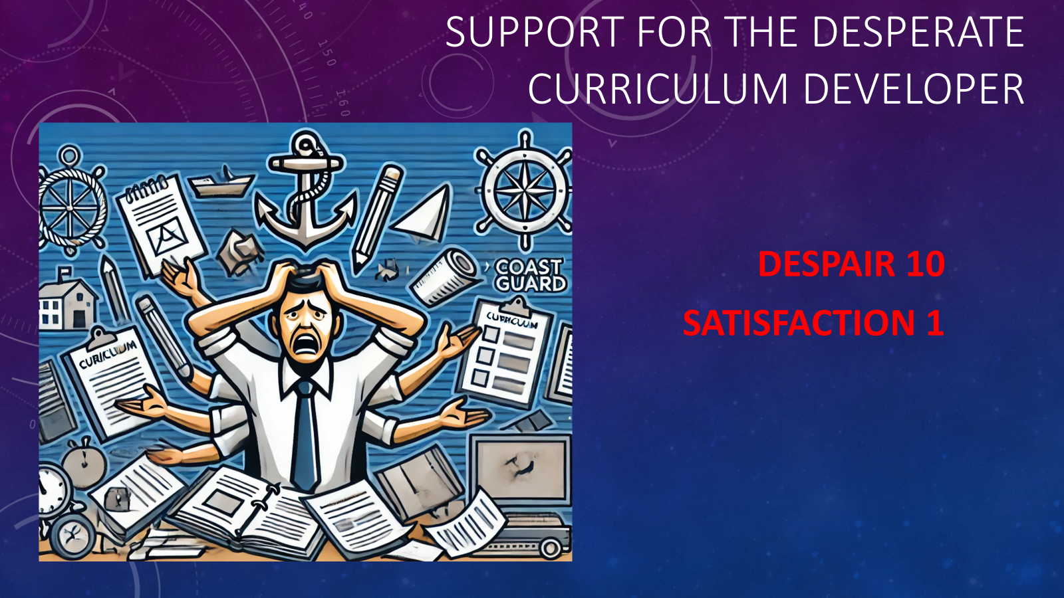
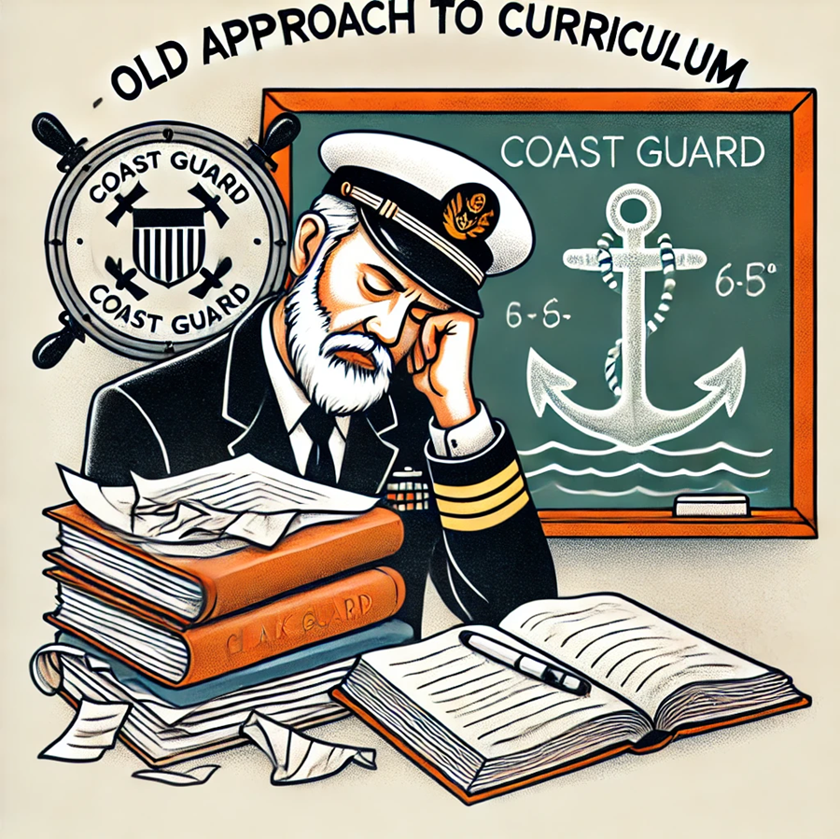

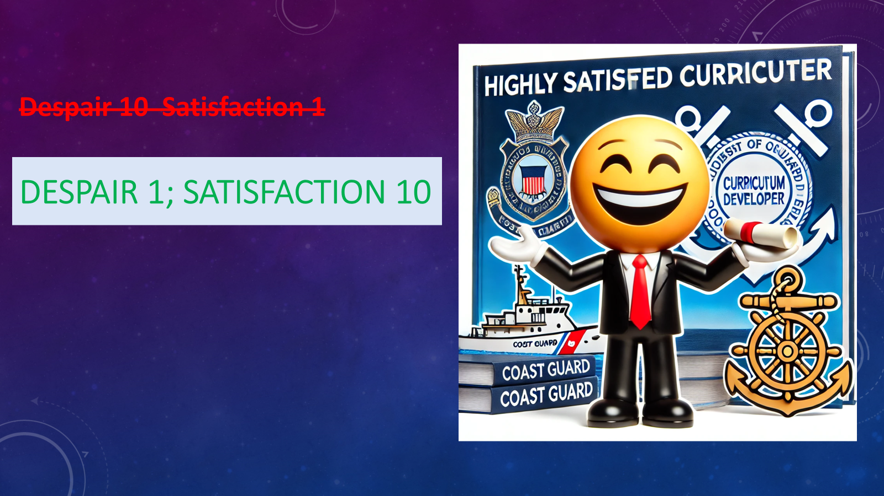
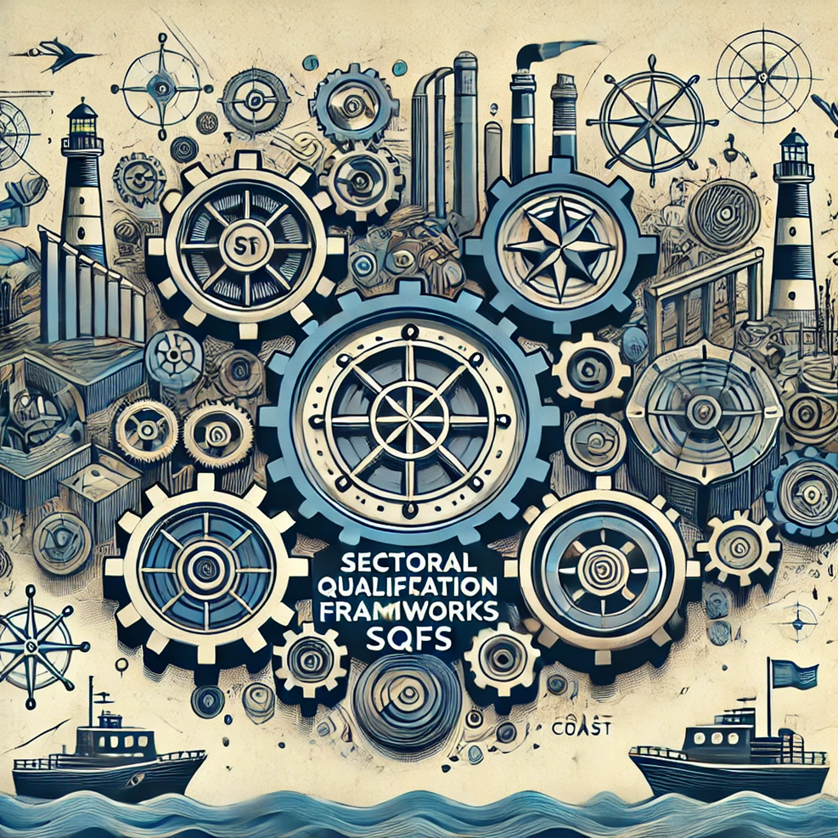
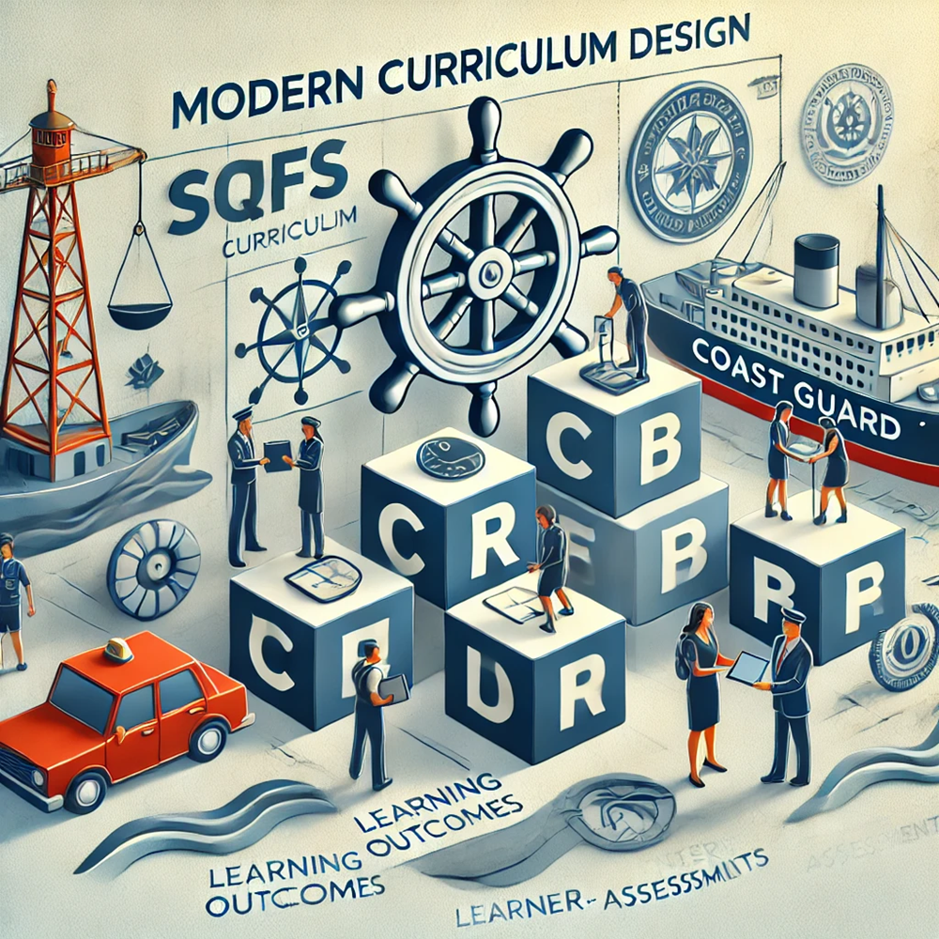
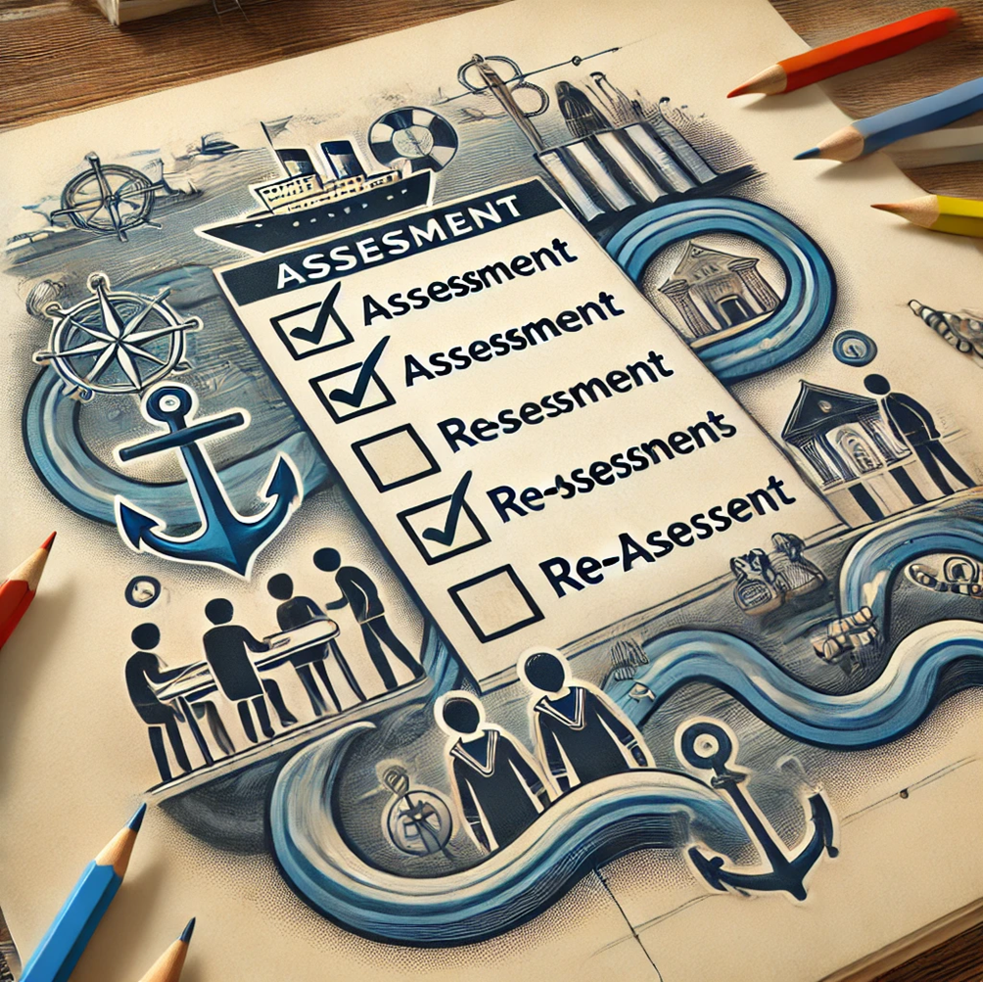
Teacher centred approach
Learner centred approach
Notes:
Modern curriculum design incorporates tailored learning outcomes, learner-centered activities, and relevant assessment methods. This approach leads to a clear learning process, enhanced competence (as required), and transparent expectations for both teachers and learners.

Slide 13
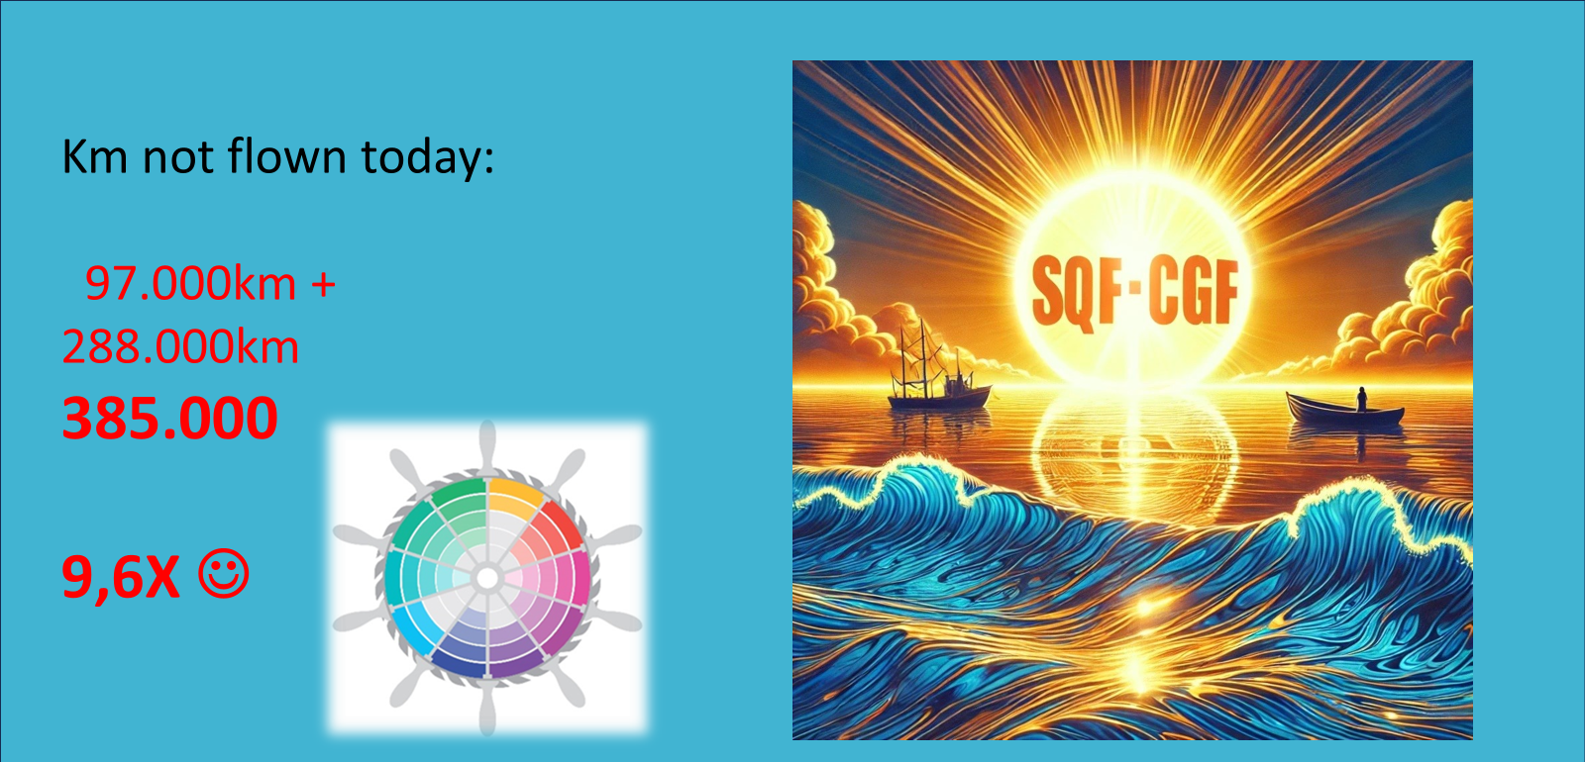
Notes:
After a final summary of the event, participants had no additional questions, and EFCA reminded everyone to complete the feedback form shared after the session. The presenter expressed heartfelt gratitude to the audience for their full engagement throughout the event. Special thanks went to Ms. Ioana Hartescu from EFCA for her thoughtful support, particularly her valuable contributions in the chat and assistance with interactive elements, such as the word cloud.
The concluding slide highlighted an impressive fact: by participating remotely in all four online sessions, attendees collectively avoided flying approximately 385,000 kilometers. This incredible distance would have required nearly 10 trips around the world by plane, underscoring a significant environmental benefit.
EFCA is deeply committed to environmental protection, and presenter Heinz Schneider is particularly proud of this achievement. He extends his best wishes for the success of the upcoming SQFCGF alignment process.
Together, we’ve proven that we can make a difference. Let’s keep going!

